Slide 1
Cyber Security
Rob Wagner, Alex Petitjean, Ryne Bell
Notes:
Rob

Slide 2
Secure Software Must…
Prevent unauthorized access
Recover from a system failure
Prevent corruption of data
Allow authorized users access!
Q2
Notes:
Rob

Slide 3
Important Quality Attributes
Thorough testing strategies
Monitoring system capabilities
Secure coding
Q3
Notes:
Rob

Slide 4
Thorough testing strategies
Any major security bug must be removed before release
System needs to be maintained to ensure a satisfied user base
Notes:
Alex

Slide 5
Monitoring system capabilities
Data must be secure, but also accessible
System must be able to handle stress
System must be able to recover from a crash without data corruption
Notes:
Alex

Slide 6
Secure coding
Developers need to be aware of vulnerabilities in their software
Must protect against things like buffer overflows and code injection
Notes:
Alex

Slide 7
How Do You Ensure Quality
Breaking the system up into smaller components
Complexity of individual components is reduced
Techniques such as automated theorem can be used to prove the correctness of crucial software subsystems
Notes:
Ryne

Slide 8
HOW DO YOU ENSURE Quality?
“Defense in depth” - multiple subsystems must be violated to compromise the entire system
When formal proofs are not possible, rigorous code review and unit testing are used
Notes:
Ryne

Slide 9
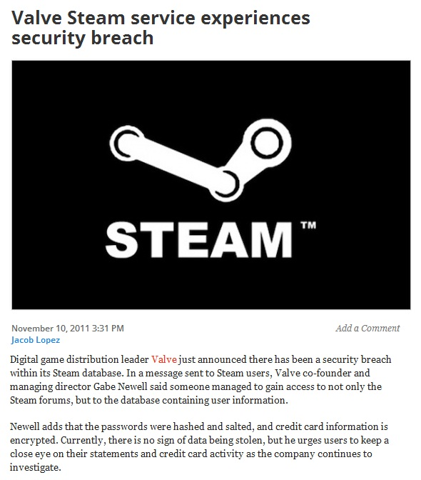
Q4
Notes:
SRC: http://venturebeat.com/2011/11/10/valve-steam-service-experiences-security-breach/
Rob

Slide 10
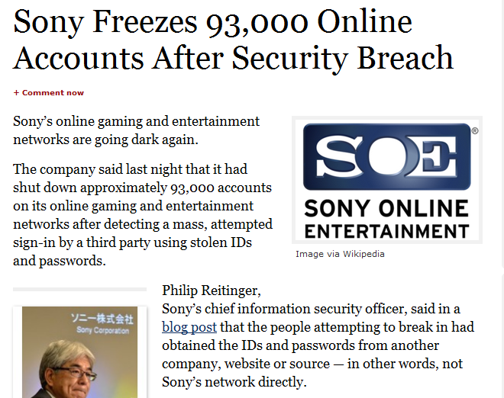
Q4
Notes:
SRC: http://www.forbes.com/sites/parmyolson/2011/10/12/sony-freezes-93000-online-accounts-after-security-breach/
Alex, then Ryne (bank stuff)

Slide 11
Important Things to Take Away
Establish trust with user base
Assume users know nothing about your system
Users should have minimum privileges and have access only to what they need
Q5
Notes:
Ryne

Slide 12
Metrics
Core vs. ecosystem
Standard metrics can be used to ensure the core works properly, but tests for the ecosystem are a little more specialized
Core functionality is tested much the same as any other code, but often with more emphasis on code review and other methods to ensure the program not only works properly, but is written in a security conscious manner
Ecosystem tests determine what the software does on a compromised system, or when a user of the software has malicious intent
Notes:
Ryne

Slide 13
Metrics
Current ratio of detections to actual infections as compared to the baseline figure
Or blockings of something malicious (depending on exactly what the software is)
Notes:
Rob

Slide 14
METRICS
“Fuzzing” - sending various types of pseudorandom data to available interfaces to discover unknown flaws present in the software
Error or vulnerability reporting in final product reported by users
Q6
Notes:
Rob

Slide 15
Suggestions – Ensuring Quality
Ratio of time spent reviewing old code to developing new
This should increase over time as the codebase becomes more complete
Number of comment lines per method
This should be higher for security sensitive sections which are reviewed often
Notes:
Ryne

Slide 16
Suggestions – Ensuring Quality
Average Method Size
This should be relatively low to make understanding each method very easy
Makes ensuring correctness easier
Penetration Testing
People who attempt to purposefully break the system in any way
These attempts should be converted into test cases if possible to keep track of the progress on preventing them, and ensuring the continue to fall to break the system
Notes:
Ryne

Slide 17
Suggestions - Metrics
Process metrics
Use of secure coding standards
Time to correct vulnerabilities
Trustworthiness of development team
Notes:
Alex

Slide 18
Suggestions - Metrics
Vulnerability metrics
Vulnerability types
% of code re-use from other projects or products
% of code that is third party
Notes:
Alex

Slide 19
Real World Example
Windows Lan Manager
Credentials compatible with many different applications
These credentials could be intercepted and used to access other applications
Notes:
Ryne

Slide 20
Standards
Carnegie Mellon’s Computer Emergency Response Team (CERT) have published secure coding standards for several languages. The standards were developed by members of their team and a community of software developers.
Q7
Notes:
Rob
http://www.cert.org/secure-coding/

